Slide 1

OS Task Manager
with Round Robin Scheduling and Visualization Techniques

Slide 2
TECHNOLOGY BEHIND THIS PROJECT
LANGUAGE USED – PYTHON
IDE USED – VISUAL STUDIO CODE
BACKBONE – ROUND ROBIN SCHEDULING

Slide 3
PROBLEM STATEMENT
A Task Scheduler program that implements the Round Robin Scheduling algorithm. The system should allow users to input tasks with their respective Process IDs (PIDs) and burst times.
Specifications:
Task Input: Users can input tasks with their Process IDs (PIDs) and burst times.
Scheduling: Implement the Round Robin Scheduling algorithm to execute the tasks.
Execution: Execute tasks based on the specified quantum time slice.
Output: Display the execution process and completion of tasks, along with the turnaround time and waiting time for each task.
Metrics: Calculate and display the average waiting time for all tasks.

Slide 4
PROBLEM STATEMENT
Implementation Requirements:
Use a graphical interface to input tasks and display the execution process.
Display the output of the scheduler, including the tasks' execution process, turnaround time, waiting time, and average waiting time.
Visualize the execution metrics using suitable charts/graphs (e.g., pie charts, bar graphs) for task execution, turnaround time, and waiting time.

Slide 5
USES OF TASK MANAGER
Cpu Optimization
Resource Allocation
Performance Analysis
Optimization and Efficiency
This project also uses visualization libraries like tkinter for better readability

Slide 6
USES OF ROUND ROBIN SCHEDULING IN TASK MANAGER
Fairness: Round-robin ensures fairness among processes by providing each process with an equal share of CPU time in a cyclic manner. This prevents a single task from monopolizing the CPU for an extended period, ensuring that all tasks get a chance to execute.
Prevention of Starvation: By allowing tasks to execute in a time-sliced manner, round-robin prevents any particular task from being indefinitely delayed or starved of CPU time.
Simplicity: The round-robin algorithm is relatively easy to implement and understand, making it suitable for demonstration and educational purposes.
Reasonable Performance: For many general-purpose scenarios, round-robin provides reasonable performance in terms of response time and throughput.
Predictability: Round-robin scheduling has predictable behavior, making it easier to simulate and analyze in programs like the Task Scheduler application.

Slide 7

REQUIREMENTS
HARDWARE REQUIREMENTS:
COMPUTER
DISPLAY
CPU
MEMORY(RAM AND ROM)
I/O DEVICES (KEYBOARD, MOUSE, ETC…)
SOFTWARE REQUIREMENTS:
OPERATING SYSTEM
PYTHON
AN IDE(VISUAL STUDIO CODE)
LIBRARIES (TKINTER AND PLOTLY)

Slide 8
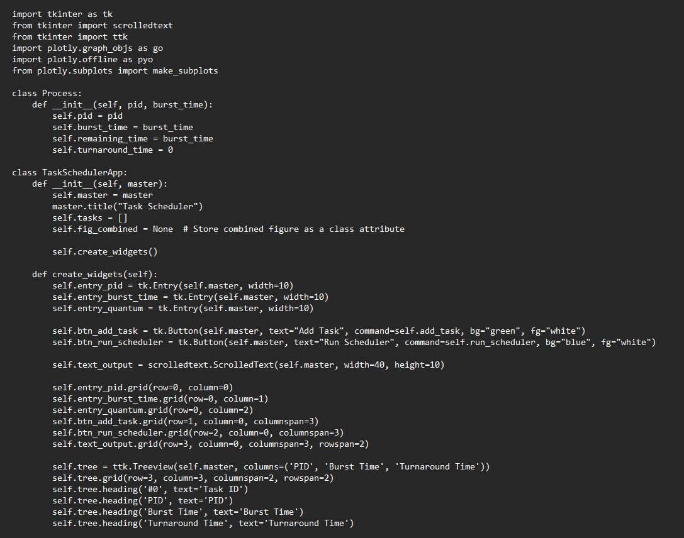
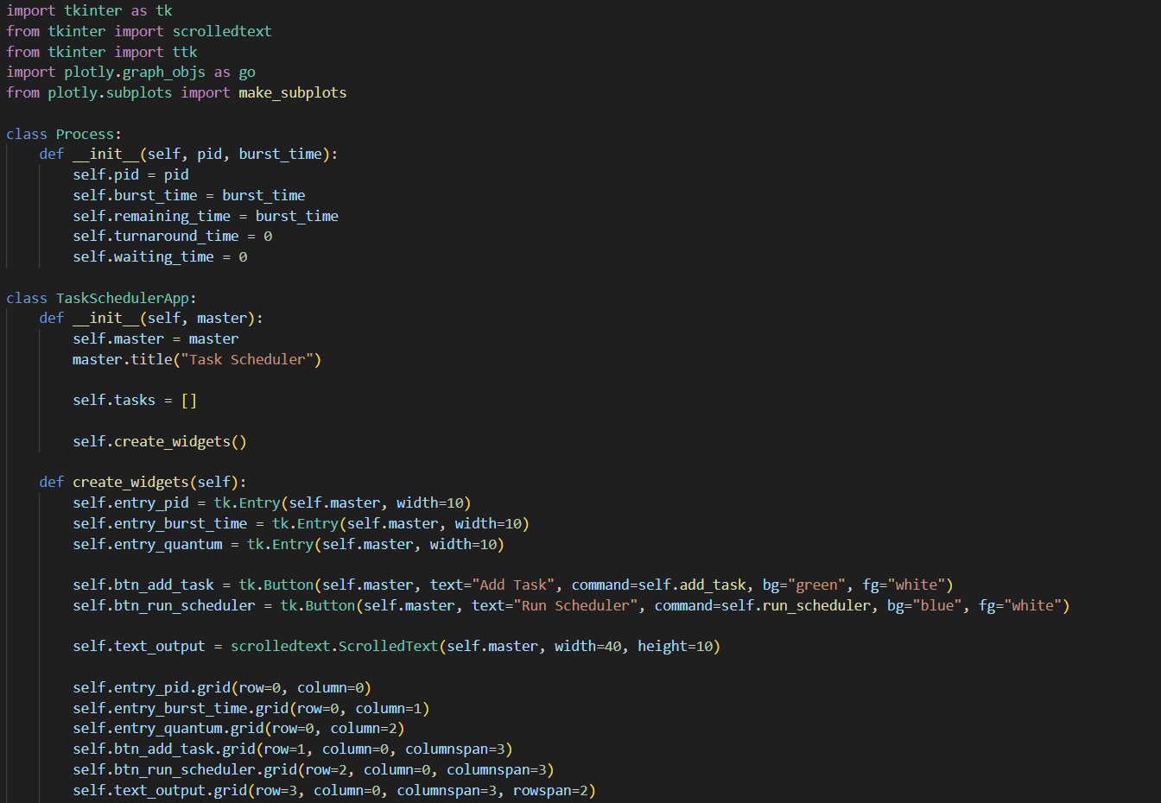

Slide 10
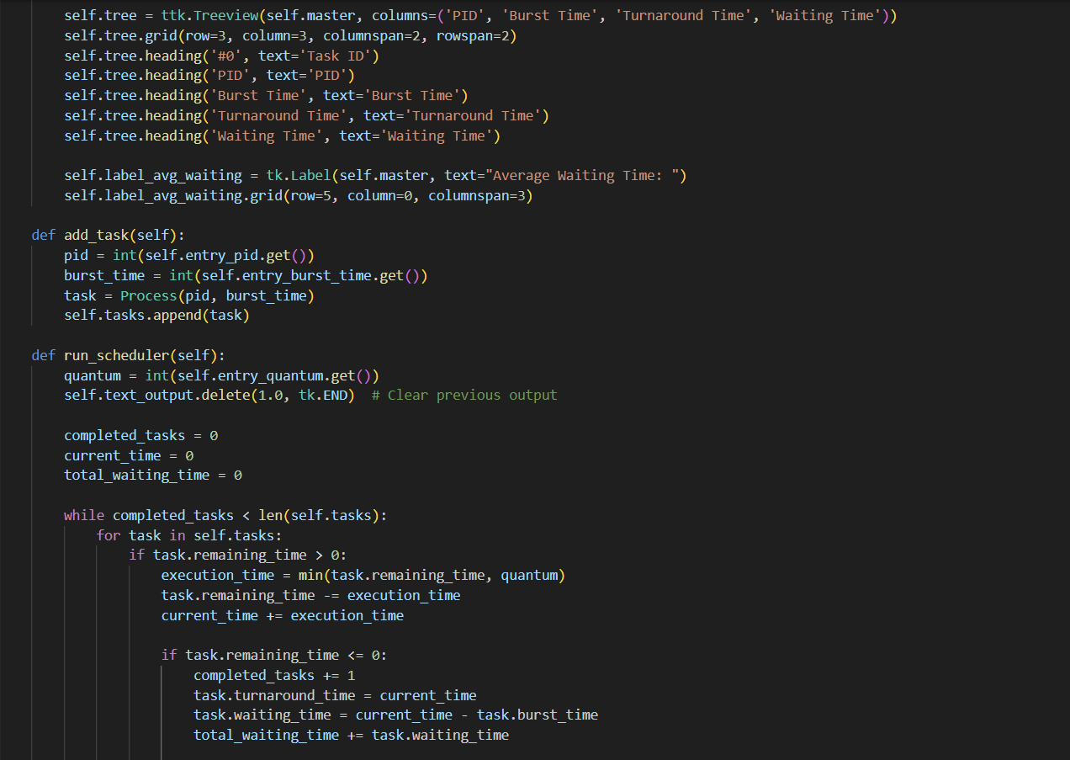
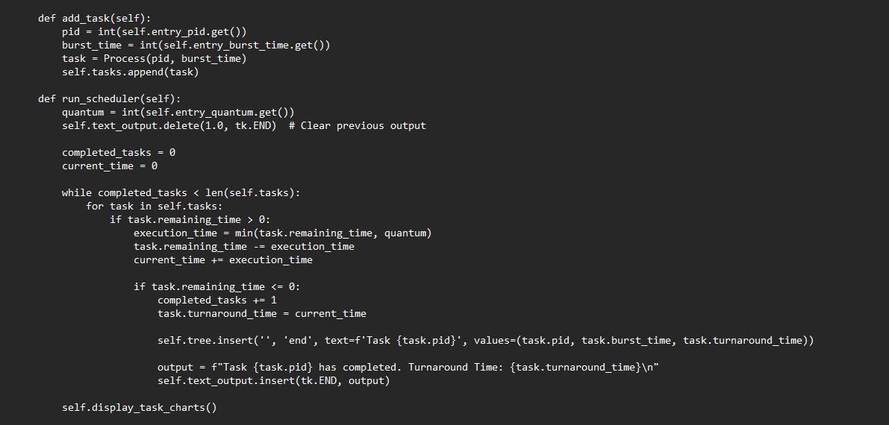

Slide 11
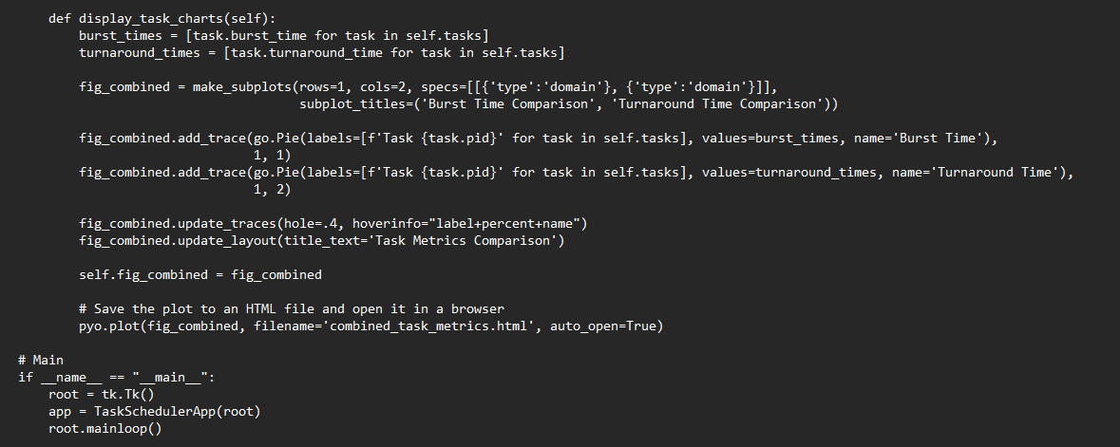
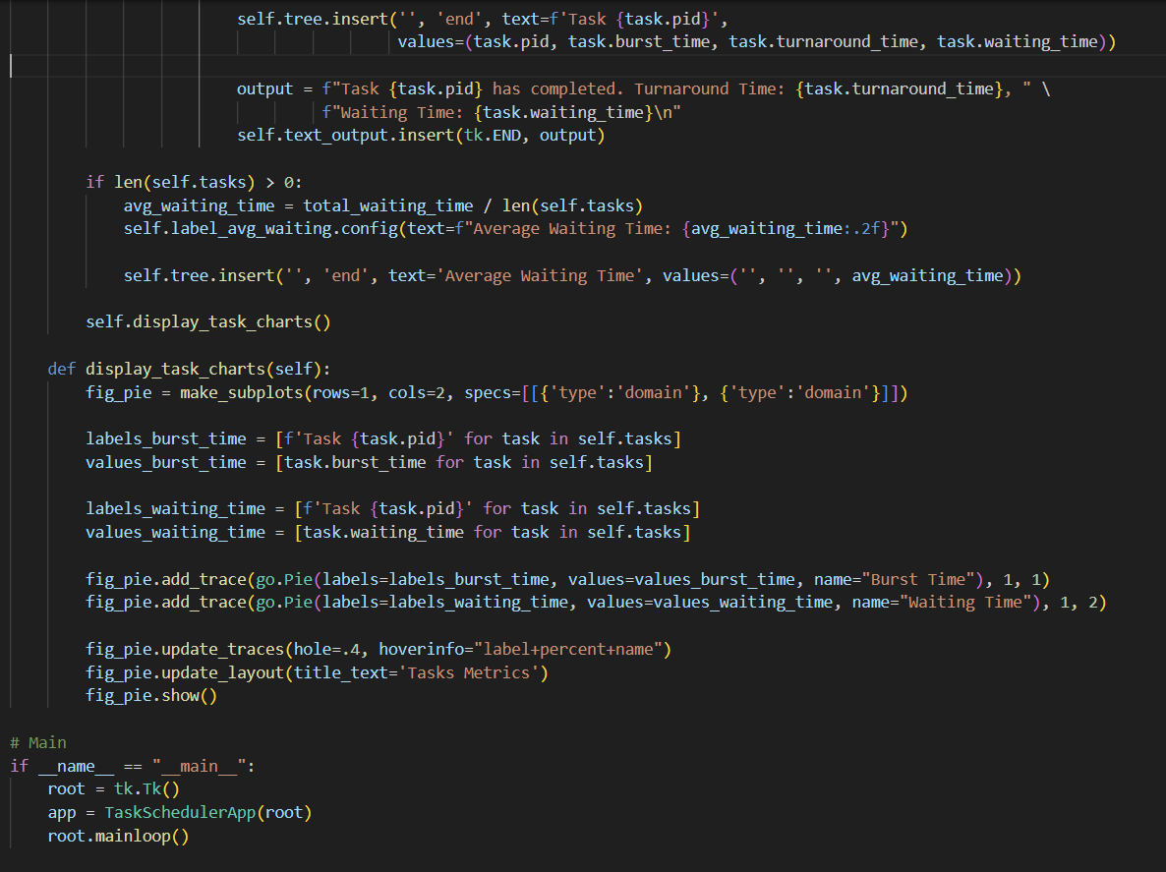

Slide 12
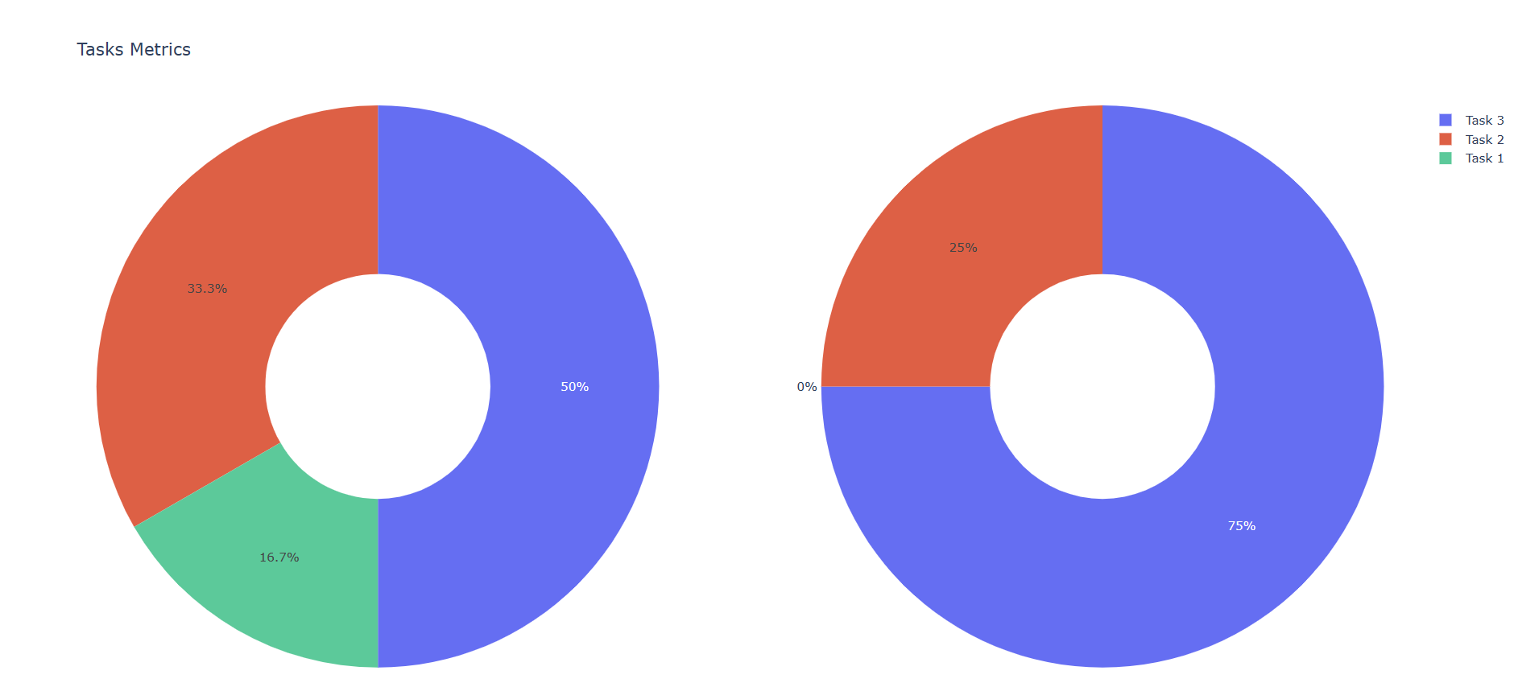
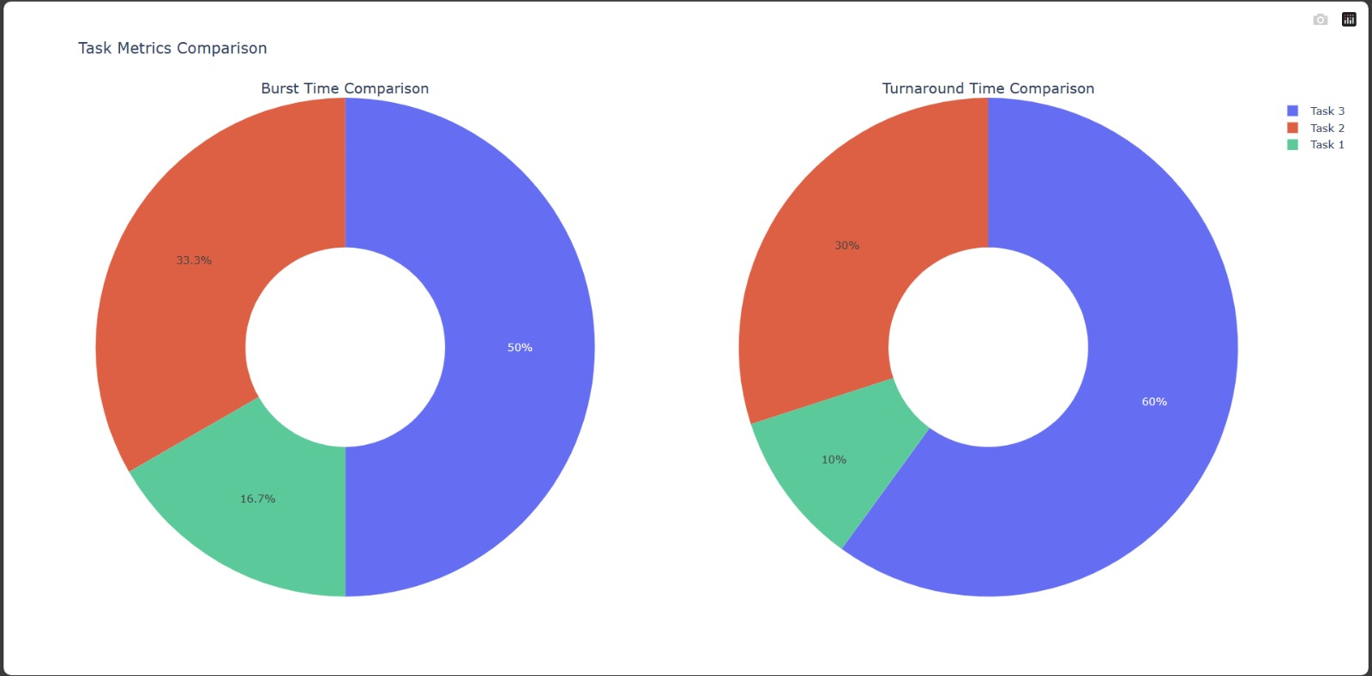
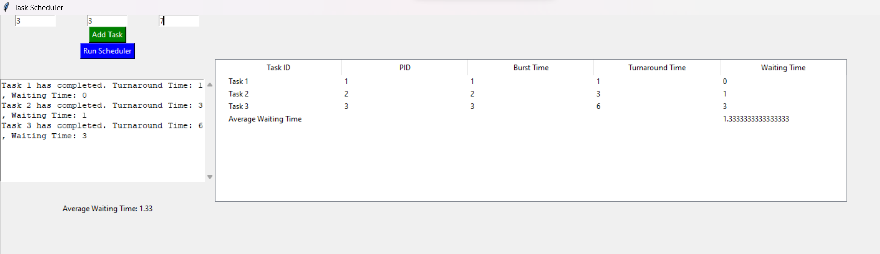
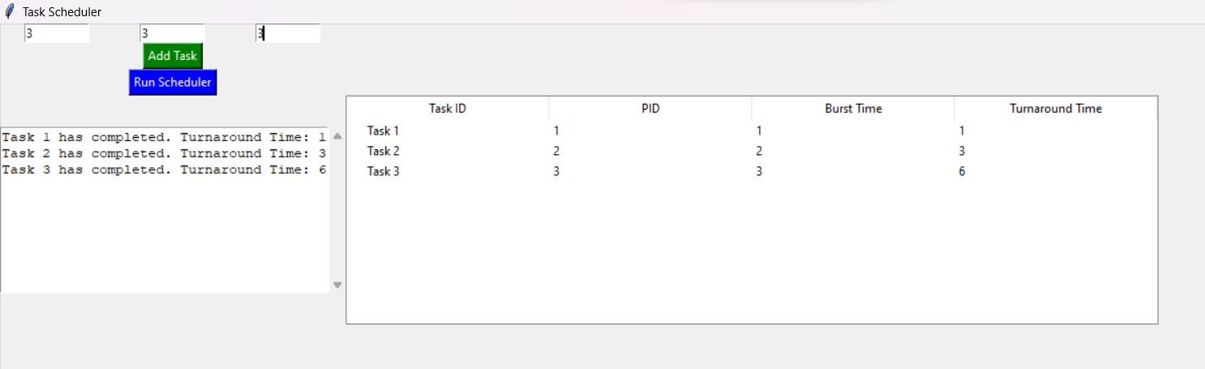
OUTPUT

